Slide 1
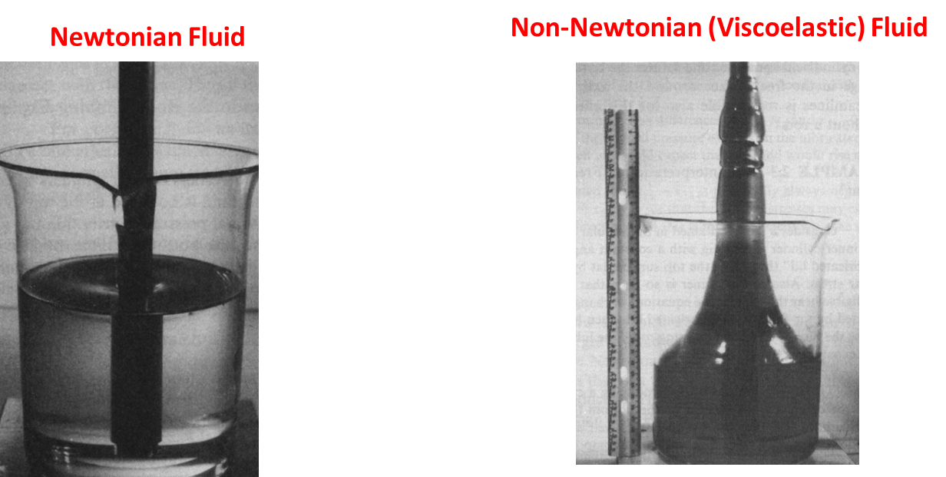
VISCOELASTICITY

Slide 2
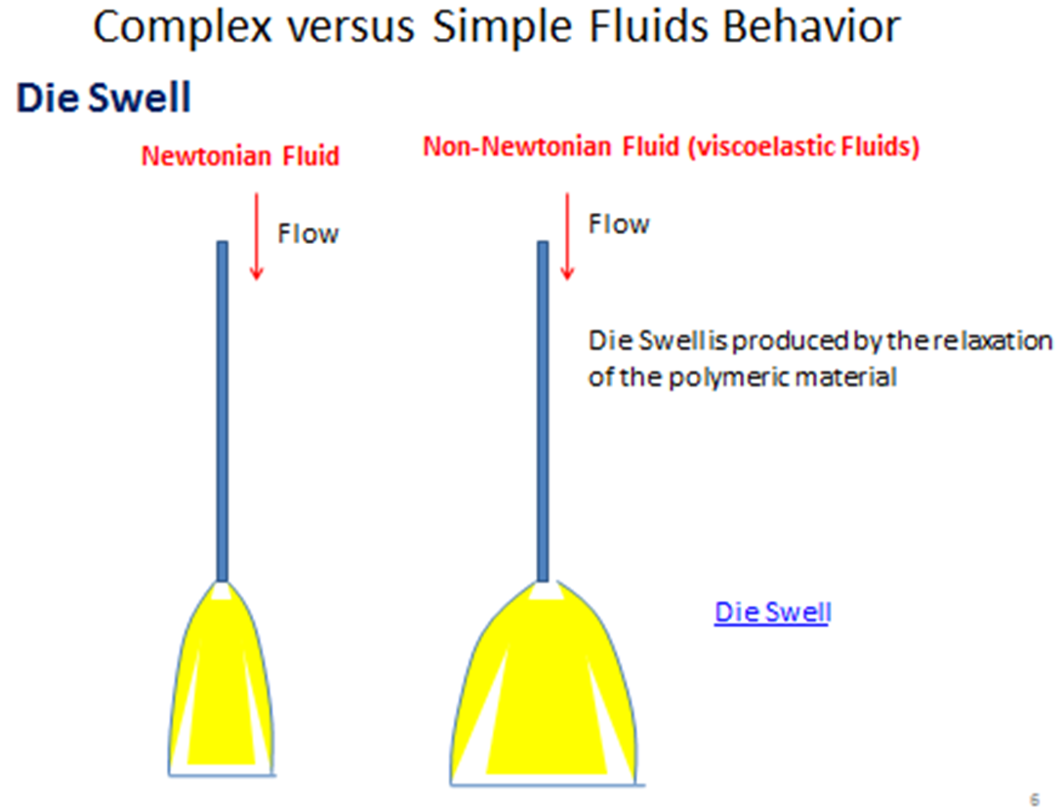
VISCOELASTICITY

Slide 3
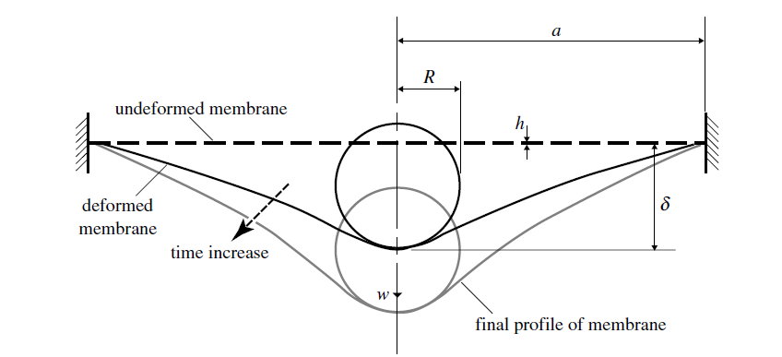
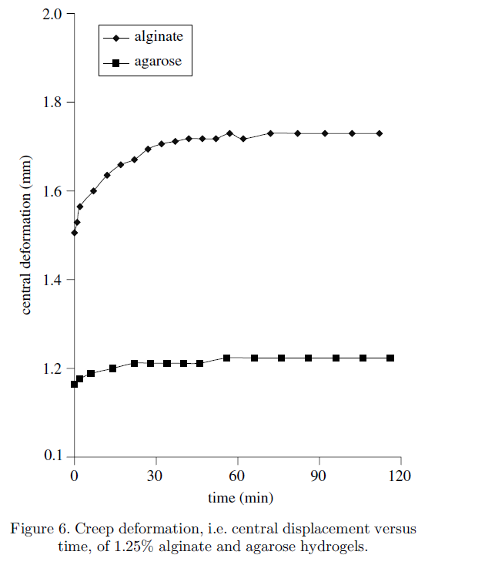
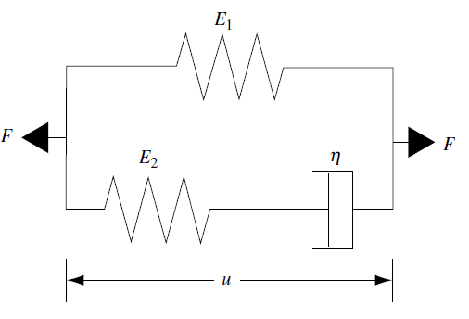
VISCOELASTICITY
Experimental Test
Engineering representation of the test
Test results
Model
Characterization the viscoelastic properties of thin hydrogel-based construct for tissue engineering applications

Slide 4
VISCOELASTICITY

Slide 5
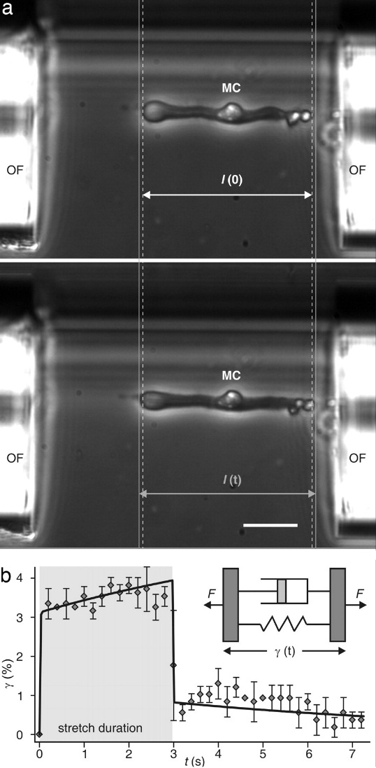
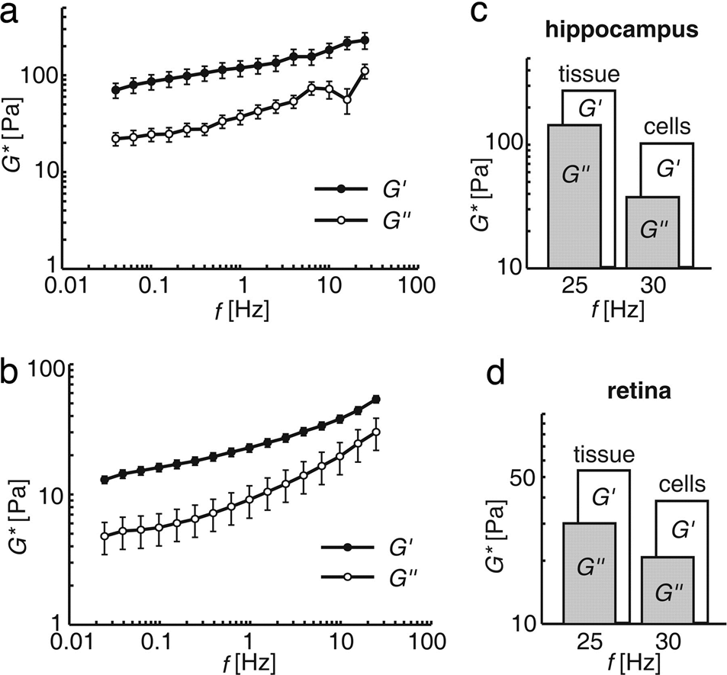
Mechanical deformation and relaxation behavior of a whole Müller (glial) cell (MC) deformed with an optical stretcher.
VISCOELASTICITY
Yun-Bi Lu et al. PNAS 2006;103:17759-1776
©2006 by National Academy of Sciences

Slide 6
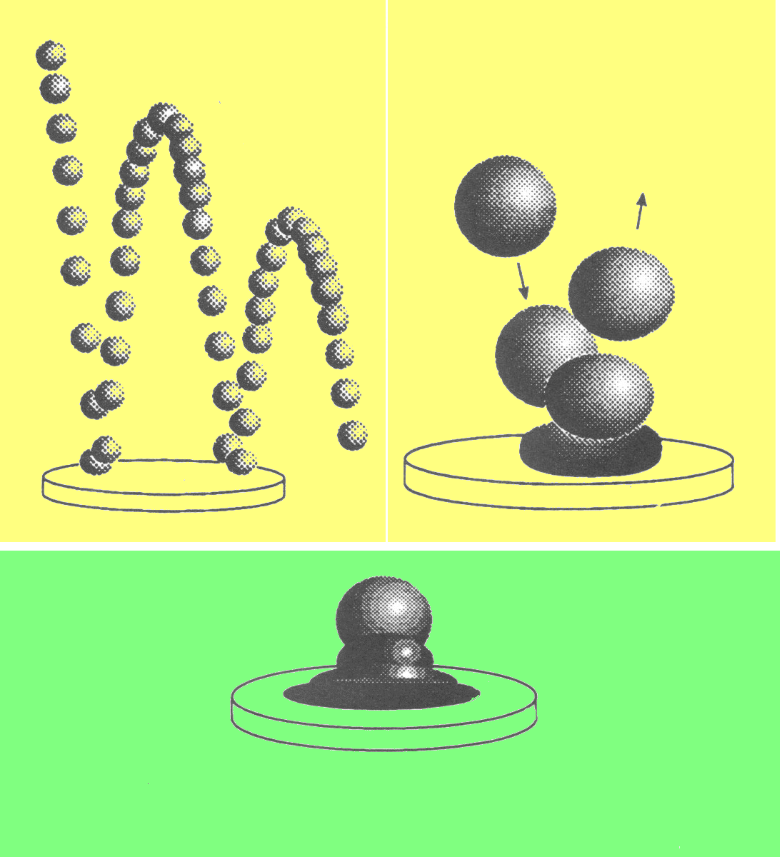
VISCOELASTICITY
A viscoelastic material (depending on time, it may be behave either as solid or liquid). At short times it behaves as a solid, at long times it behaves as a liquid
SHORT TIMES
LONG TIMES

Slide 7
Viscoelastic Materials
TIME is an important variable to study these materials
Time
Frequency
High Frequencies
Short Times
(Solid/Elastic Behavior)
Low Frequencies
Long Times (Fluid/Viscous Behavior)
Could we relate a “rheological parameter” of the material
with its viscoelastic behavior?

Slide 8
CONCEPT OF VISCOELASTICITY
Maxwell: Viscous flow is the manifestation of the decay of elastically stored energy
High Energy (Stored “elastic” energy)
Deformation
Relaxation (or flow)
Experimental time
t_{exp}
Relaxation time
t_{R}
Low Energy
Low Energy

Slide 9
Viscoelastic Behavior t_{R} is a material property
We should measure viscosity,
We should measure elasticity, G
Elastic Modulus

Slide 10
VISCOELASTICITY
Is water a viscoelastic Material ?
t_{R}= 10⁻¹² sec

Slide 11
ELASTIC SOLID
LIQUID
" SPRING " ~ SOLID
L
" DASHPOT" ~ LIQUID
L
F proportional
to Deformation
F proportional to the Rate of Deformation
F
F
to
t1
TIME
TIME
L
L
Permanent
Deformation
TIME
TIME
to
t1
DEFORMATION FOLLOWS THE FORCE
DEFORMATION DOES NOT
FOLLOW THE FORCE
FORCE AND DEFORMATION ARE “ IN PHASE “
FORCE AND DEFORMATION ARE “ OUT OF PHASE ”

Slide 12
Viscoelastic Measurements
Torque bar
Storage Modulus
Bob
Sample
Cup
Loss Modulus
Oscillator
Phase Angle δ
Loss Tangent
Strain γ
Stress σ

Slide 13
OSCILLATORY TESTING
Samples are subjected to harmonically varying stress (controlled
stress instrument) or strain (controlled strain instruments)
What are you meaning with this?
Shear Experiment
Sample
h
Plate Displacement versus time
“Shear” Strain versus time

Slide 14
OSCILLATORY TESTING
Shear Experiment
Sample
h
Oscillation amplitude.
It can be fixed
Frequency = 1/s = Hertz

Slide 15
OSCILLATORY TESTING (Small strain (deformation))
Shear Experiment
Sample
h
Assume plate separated by 1.5mm (h=1.5mm)
Assume that plate displacement is 0.3mm (L_{o}=0.3mm)
If Lo = 0.15mm (

Slide 16
OTHER TYPE OF DEFORMATIONS CAN BE USED
Compression Tension
Engineering Stress and Strain
True Stress and Strain
Bending
b
Double Cantilever
Single Cantilever
a
F
a
F
h
d
d
Rectangular Section
Rectangular Section
D
Circular Section
E is the elastic or Young
Modulus
Circular Section

Slide 17
CONTROLLED STRESS INSTRUMENTS
Input
Frequency
(fixed by the user)
Stress Amplitude
(fixed by the user)
Output
Strain Amplitude
(measured)
Phase Angle
(measured)
Measured
Measured

Slide 18
CONTROLLED STRAIN INSTRUMENTS
Input
Frequency
(fixed by user)
Strain Amplitude
(fixed by user)
Output
Stress Amplitude
(measured)
Phase Angle
(measured)
Solid Behavior
Liquid Behavior

Slide 19
Oscillatory Testing
Solid Behavior
Liquid Behavior
Storage Modulus
Loss Modulus
tan (Phase Angle)

Slide 20
Oscillatory Testing
Other Viscoelastic Parameters (from Controlled Strain)
Complex Modulus
Complex Viscosity
Dynamic Viscosity
Out of Phase Viscosity

Slide 21
Oscillatory Testing
Other Viscoelastic Parameters (from Controlled Stress)
Complex Compliance
Storage Compliance
Loss Compliance

Slide 22
VISCOELATIC MATERIALS
Solid (elastic) and Liquid (viscous) Behavior !!!!
G
Dashpot
Spring

Slide 23
VISCOELATIC MATERIALS
Maxwell Element
What is the stress applied ?
Is the stress the same for the spring and the dashpot ?
What are the strains in the dashpot and the spring ?
Are these strains equals? and how can be calculated ?
How we combine these two elements ?
G
Answering those questions will
allow us to get a model for the
Maxwell Element
Relaxation Time

Slide 24
What happens if a Maxwell Element is oscillated ?
Maxwell Element
Storage Modulus
Loss Modulus
G
Solid Behavior

Slide 25
Biomaterials are more complex than
a single Maxwell
Four Element
G₁
G₂
Generalized Maxwell
G₁
G₂
G₃
G_{n}

Slide 26
Oscillatory Testing
Oscillatory testing is based on inputs (either stress or strain)
that are sine waves ?
How could be sure that strain and stress are harmonically
varying functions (e.g. sine or cosine functions) ?
See raw data for stress and strain as a function of time
Sometimes is hard to get raw data
How does data look like ?
Output(it is generally jagged)
Input(it is generally OK)

Slide 27
Oscillatory Testing
Filtering of
these frequencies
Fourier
Transform
Calculation of
G’
G”
and others

Slide 28
How could be sure, without seeing the raw data and
the transformation process that both strain and stress
are harmonically varying functions (e.g sine or cosine)?
Concept of Linear Viscoelasticity
The response (rheological) of a material to a harmonic (e.g. sine)
varying function will be also harmonic (sine) if the material
behavior is linear
Output
Linear Material
Behavior
Input
Sine Function
Sine Function
Output
Input
Non-Linear
Material Behavior
?
Sine Function

Slide 29
How could we determine whether the behavior
of the material is linear?
LINEAR BEHAVIOR
If is increased then is increased by the same extent
For instances, if is increased by 20% then is increased by 20%
So G’ and G” will not change if either or are changed
Non-Linear
Behavior
Linear
Behavior
Stress Sweep Test (Controlled Stress
Strain Sweep Test (Controlled Strain)

Slide 30
Linear Viscoelastic Region

Slide 31
OTHER TESTS THAT ARE DONE TO
MEASURE VISCOELASTICITY
Frequency Sweep
Maxwell Element
Generalized Maxwell Element
G₁
G₂
G₃
G_{n}

Slide 32
Why do we need to study viscoelastic
materials at different frequencies ?
Solid Material, it is frequency independent
Equations can be used to determine the
relaxation times of materials. Relaxation times are associated with the material molecular structure that provides a good understanding of simple polymeric materials (de Gennes received the Nobel Prize for some of the interpretations and description of molecular behavior). Analysis is harder for food and complex biomaterials.
For a Maxwell Element
Elastic component
Viscous component

Slide 33
OTHER EXPERIMENTS
Time/Temperature Sweep
Applications
Cheese production
Gelation reactions
Chemorheology (following
chemical reactions with
changes in rheology of
material
Softening of chocolate due to fat melting
thickening of starch suspensions
due to starch gelatinization
Interaction among components
(proteins and carbohydrates)
Cheese production
Dough Resting
Adding Enzyme
(Rennet)
Frequency constant
Time
t_{coagulation}

Slide 34
Oscillatory Testing
Parallel Plate
h
At the rim of the top plate the distance
traveled x can be calculated as:
R
And the strain can be calculated as:
Let’s assume that h=2mm and R=50mm and the
amplitude of the strain is 10%, i.e.

Slide 35
Oscillatory Testing
Cone and Plate
Strain
Cone angle
2-4 degrees
If strain is 10%, i.e.
Concentric Cylinders
Newtonian Fluid
Power-law Fluid

Slide 36
TIME TO COMPLETE AN OSILLATORY TEST
At least one cycle should be
completed to gather meaningful
data
Time to complete a cycle
depends on frequency
For example for
For

Slide 37
Effect of Moisture Content and sample
“aging” in rheometer
Wheat Starch at different moisture contents
Low moisture contents are preferable on long tests
For high moisture
contents use short tests
T=90ºC
9.5%
14%

Slide 38
Controlled Stress versus Controlled Strain
Steady shear tests versus oscillatory tests

Slide 39
Effect of molecular weight of starch
on rheological properties
Potato Starch
Mw=1.7x10⁷- 3.5x10⁸
Wheat Starch
Mw=1.5x10⁷- 8.8x10⁷
32% Glycerol, 0% moisture, 150ºC

Slide 40
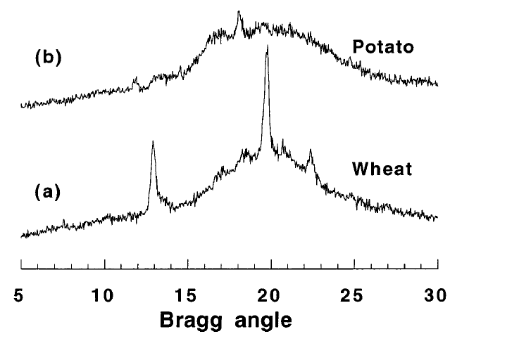
X-ray diffraction patterns of wheat and potato starch
8% crystallinity
23% crystallinity

Slide 41
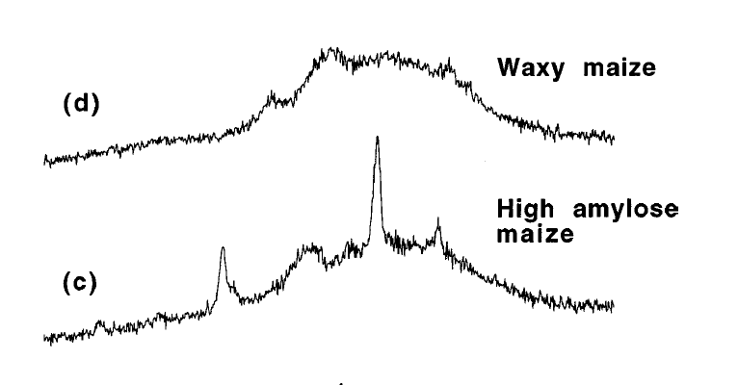
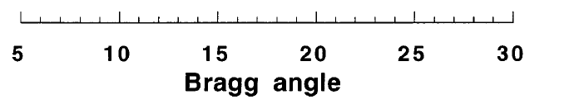
Amorphous material
about 20-23% crystallinity

Slide 42
High Amylose Starch
Mw= 5x10⁶
Waxy Starch
(Amylopectin)
Mw=7.5x10⁷

Slide 43
Effect of Temperature on viscoelastic properties
G’
G”

